Slide 1
Digital Portfolio
STUDENT NAME: Shegan Balg Shervin S
REGISTER NO AND NMID: 2428C0516 & 3E83430E7442CDC8584427907128270E
DEPARTMENT: Bsc AIML
COLLEGE: KPR College of Arts Science and Research

Slide 2
PROJECT TITLE
NGO Worker Portfolio Website

Slide 3


AGENDA
Problem Statement
Project Overview
End Users
Tools and Technologies
Portfolio design and Layout
Features and Functionality
Results and Screenshots
Conclusion
Github Link
3/21/2024 Annual Review

Slide 4

PROBLEM STATEMENT
Students engaged in NGO and social service work often struggle to
showcase their contributions and impact.
Traditional resumes fail to capture community engagement,
volunteer work, and social projects effectively.
A portfolio website provides a professional way to present NGO work,
highlight contributions, and build trust with communities, mentors,
and recruiters.

Slide 5

PROJECT OVERVIEW
The NGO Worker Portfolio is designed to showcase my passion for
community service, leadership, and social impact projects.
It highlights the events and initiatives I have organized, my
skills in collaboration, and my dedication to making a difference.
This portfolio serves as a digital identity to connect with
organizations and inspire more participation in NGO activities.

Slide 6

WHO ARE THE END USERS?
- Non-Governmental Organizations (NGOs)
- Community Leaders and Volunteers
- Sponsors and Partners
- Professors and Mentors
- Recruiters and Placement Officers

Slide 7

TOOLS AND TECHNIQUES
- HTML5 (website structure)
- CSS3 (styling, 3D effects, animations)
- JavaScript (smooth scrolling, interactivity)
- GitHub Pages (deployment platform)
- VS Code (development environment)

Slide 8
POTFOLIO DESIGN AND LAYOUT
- Green gradient theme representing growth and sustainability
- Sections: About, Skills, Projects, Contact
- 3D hover card effects for interactive experience
- Sticky navigation bar with smooth scroll
- Responsive design for mobile and desktop devices
8

Slide 9
FEATURES AND FUNCTIONALITY
- About section introducing me as an NGO worker
- Skills section showcasing leadership and community engagement
- Projects highlighting social service drives and awareness campaigns
- Contact form for collaboration and networking
- Professional, modern UI with animations and 3D effects

Slide 10

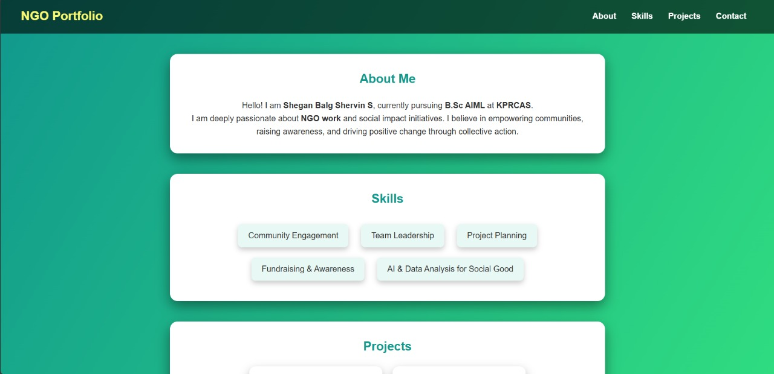
RESULTS AND SCREENSHOTS
Results:
- A professional NGO Worker Portfolio website
- Showcased projects: Food Donation Drive, Awareness Campaign,
AI for Social Good
- Created a digital presence to share and inspire community work
Screenshots:
3/21/2024 Annual Review
10

Slide 11
CONCLUSION
The NGO Worker Portfolio successfully provides a professional
platform to present my contributions to social impact initiatives.
It builds credibility, enhances visibility, and inspires future
opportunities for collaboration.
Future Scope:
- Adding event gallery for NGO activities
- Integration with NGO social media handles
- Volunteer registration and feedback system
11

Slide 12
Git Hub Link: NGO Work Portfolio: https://github.com/shegg0210/Ngo-portfolio-

